Slide 1
Latent Space, Explicit and Implicit Generative Models
John R Ballesteros
Profesor Titular UN
jballes@unal.edu.co

Slide 2
Why do we need generative models?
Data augmentation
Simulation
drug discovery
Art
other

Slide 3
Latent Variable and Latent Space
A latent variable is a compressed representation of the data, encoding essential characteristics that the model uses to generate new samples. For example, in an image of a face, latent variables might encode features like "eye shape," "skin tone," or "expression“ and others.
A latent space is the abstract, multidimensional space where latent variables live. Each point in this space represents a possible combination of latent variable values, and each point corresponds to a potential output in the data space (e.g., a specific image or sentence). The latent space is typically lower-dimensional than the original data, making it a compressed representation that captures the most important patterns.

Slide 4
Properties of Latent Space
Continuous: Nearby points in latent space produce similar outputs (e.g., slightly different faces).
Structured: The space is organized so that meaningful variations (e.g., changing expression but keeping identity) correspond to specific directions or dimensions.
Learned: The model learns the latent space during training to capture the data’s distribution.

Slide 5
Type of Generative Models
Generative models aim to learn the underlying probability distribution of a given dataset.
This allows them to create new data samples that resemble the training data.
These models broadly fall into two main classes: explicit and implicit.

Slide 6
Explicit Models
define an explicit probability function for discrete data pθ​(x), where θ represents the model parameters. The learning process typically involves maximizing the likelihood of the training data with respect to these parameters.
Learn a function that explicitly tells the probability of observing a given data point.
Likelihood-based: Training often involves directly optimizing the likelihood P(X∣θ) or the log-likelihood logP(X∣θ) of the observed data X.
Sampling: Generating new samples can sometimes be direct, but in many cases, it might involve procedures like Markov Chain Monte Carlo (MCMC) if the distribution is complex and intractable to sample from directly.

Slide 7
Characteristics
Measure Likelihood: directly calculate the likelihood of a given sample under the model. This is useful for model comparison and evaluation, often tractable (or approximable).
Tractable Density Models: The density function pθ​(x) can be computed efficiently. Examples include:
Autoregressive Models: These model the joint distribution as a product of conditional distributions, like p(x)=∏i​p(xi​∣x1​,...,xi−1​). Think of models like PixelRNN, PixelCNN, WaveNet, and language models (e.g., GPT).
Normalizing Flows: These transform a simple base distribution (e.g., Gaussian) through a series of invertible functions with tractable Jacobians. The change of variables formula is key here. Examples include NICE, RealNVP, Glow, and FFJORD.

Slide 8
Approximate Density Models: The explicit density is intractable, but approximations are used for training. Examples include: Variational Autoencoders (VAEs): These introduce a latent variable z and optimize a lower bound on the log-likelihood (the Evidence Lower Bound or ELBO). They explicitly model pθ​(x∣z) and pθ​(z), and approximate the intractable posterior pθ​(z∣x) with a learned encoder qϕ​(z∣x).
Other approaches: score matching or diffusion processes which explicitly define the gradient of the log-density (the score function).
Diffusion models (e.g., DDPMs, Score-SDE) can be seen as defining an explicit likelihood through a sequence of noise additions.
High-Resolution Image Synthesis with Latent Diffusion Models
Robin Rombach, Andreas Blattmann, Dominik Lorenz, Patrick Esser, Björn Ommer, 2021

Slide 9
Advantages:
Good for Density Estimation: By definition, they provide a way to estimate the probability of new points.
Principled Training: Likelihood maximization is a well-understood statistical framework.
Often Better Mode Coverage: Compared to some implicit models, they might be less prone to mode collapse, especially VAEs and flow-based models.

Slide 10
Disadvantages:
May Generate Blurry Samples: Especially older VAEs, due to approximations made or the choice of loss function (e.g., MSE can lead to averaging effects).
Inflexibility/Restrictive Assumptions: Tractable models often impose strong constraints on the architecture (e.g., autoregressive structure, invertibility in flows) to ensure the density can be computed.
Optimization Challenges: Maximizing likelihood for highly complex distributions can be difficult. Approximations (like in VAEs) can lead to a gap between the true likelihood and what's being optimized.

Slide 11
VAEs (Variational Autoencoders)
Define a generative process involving latent variables z. They assume pθ​(x,z)=pθ​(x∣z)p(z), where p(z) is a prior (e.g., Gaussian) and pθ​(x∣z) is the likelihood of x given z (e.g., a Gaussian distribution whose mean and variance are outputs of a decoder network).
The marginal likelihood pθ​(x)=∫pθ​(x∣z)p(z)dz is explicitly defined, even if this integral is often intractable.
VAEs are trained by maximizing the Evidence Lower Bound (ELBO), which is a lower bound on the log-likelihood logpθ​(x). Because they work with an explicit (though perhaps intractable) definition of the likelihood and aim to maximize it (or its bound), they are considered explicit models.

Slide 12
Diffusion Models (e.g., DDPMs, Score-SDEs)
Gradually adds noise to data and then learning a reverse process to denoise and generate data. This reverse process allows for the computation of the likelihood pθ​(x).
The computation of pθ​(x) for an arbitrary x can be complex and computationally intensive (often involving an integral or sum over latent variables representing the diffusion steps), the model does define this density function.
Training involves optimizing a variational bound on the log-likelihood, similar to VAEs but with a formulation based on the diffusion process. Some formulations are also based on score matching, which is related to the gradient of the log-density ∇x​logp(x).

Slide 13
LLMs (Large Language Models)
LLMs are autoregressive. This means they generate text (or other sequences) one token at a time, where each token is conditioned on the previously generated tokens.
The joint probability of a sequence x=(x1​,x2​,...,xT​) is explicitly factored as: P(x)=P(x1​)⋅P(x2​∣x1​)⋅P(x3​∣x1​,x2​)⋅…⋅P(xT​∣x1​,...,xT−1​) Each conditional probability P(xi​∣x<i​) is explicitly computed by the model (typically via a softmax layer over the vocabulary).
Therefore, it can calculate the likelihood of any given sequence under the model.

Slide 14
Implicit Models
learn a way to directly generate samples from the desired data distribution Pdata​ without explicitly defining or learning the density function p(x). They essentially learn a transformation from a simple noise distribution (e.g., Gaussian or uniform) to the complex data distribution.
These models are black box that you can query to get samples, but they don't tell you why a sample is likely or unlikely in terms of a probability value.
No Explicit Density: You cannot directly query p(x) for a given x.
Direct Sampling: The primary focus is on the sampling mechanism.

Slide 15
Characteristics
Focus on Sample Generation: The objective functions are often designed to make the generated samples indistinguishable from real samples.
Often Adversarially Trained: Generative Adversarial Networks (GANs) are the most prominent example.

Slide 16
Advantages
High-Quality Samples: GANs, in particular, are known for producing very sharp and realistic samples, especially in image generation.
Flexibility: They don't need to impose restrictive architectural constraints for tractability of a density function.
No Need to Explicitly Define Complex Densities: This can be an advantage when the true underlying density is extremely complex and hard to parameterize.

Slide 17
Disadvantages
No Likelihood Evaluation: It's difficult to evaluate the probability of a sample or compare models based on likelihood. Evaluation often relies on qualitative assessment or indirect metrics (e.g., Inception Score, FID for images).
Training Instability: GAN training is notoriously unstable and sensitive to hyperparameter choices. It can be hard to get the generator and discrimenator to converge.
Mode Collapse: GANs can suffer from mode collapse, where the generator learns to produce only a limited variety of samples (i.e., it doesn't capture all modes of the true data distribution).
Difficult to Debug: When a GAN isn't working, it can be challenging to pinpoint why due to the adversarial nature of the training and the lack of a direct likelihood metric.

Slide 18
GANs (Generative Adversarial Networks)
GANs learn to generate data without explicitly defining a probability density function p(x) for the data x.
The generator network G learns a transformation from a noise distribution z to the data space, G(z). You can sample from it, but you cannot directly query the model for the likelihood p(x) of a given data point x.
The training objective (a minimax game between the generator and discriminator) guides the generator to produce realistic samples but doesn't involve direct likelihood maximization of p(x).

Slide 19
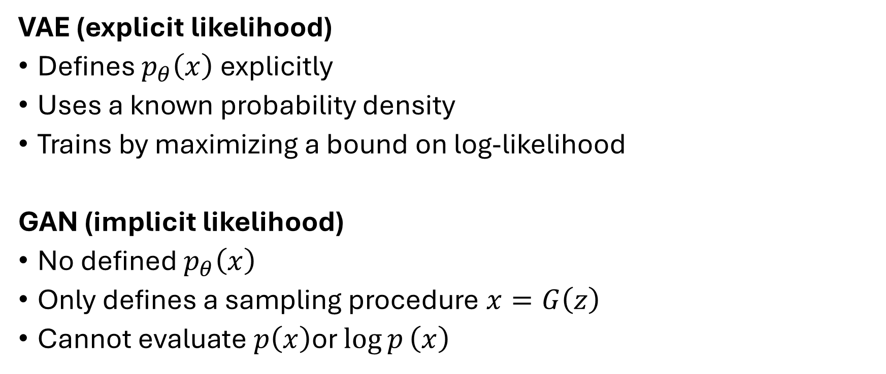
VAE (explicit likelihood)
Defines $p_{θ}\left(x\right)$ explicitly
Uses a known probability density
Trains by maximizing a bound on log-likelihood
GAN (implicit likelihood)
No defined $p_{θ}\left(x\right)$
Only defines a sampling procedure $x=G\left(z\right)$
Cannot evaluate $p\left(x\right)$or $\log{p}\left(x\right)$

Slide 20
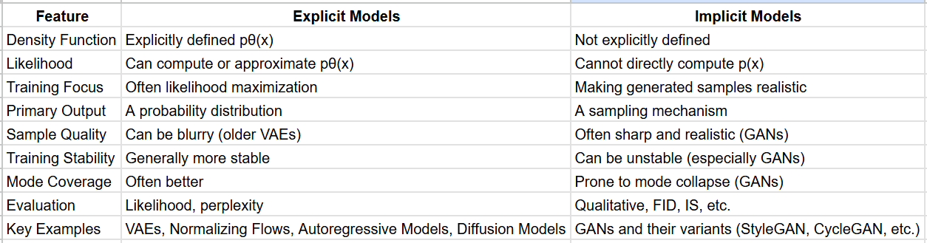
Summary

Slide 21
Visual Summary (What to look for if you compare images)
VAEs: look "impressionistic" due to smoothness/blurriness, especially in older examples. Good overall shape, but potentially lacking crisp textures.
Flows: Sharp images, good diversity. Lack of "wow" of the GANs/Diffusion in hyperrealism for complex scenes if the model isn't deep or well-trained, but solid, reliable generation.
GANs: Very sharp, often photorealistic. Signs of mode collapse (many faces looking very similar) or subtle artifacts. Sota GANs (StyleGAN3) have incredible detail and realism.
Diffusion Models: Very sharp, highly realistic, and diverse. Can handle complex prompts (if text-to-image) and generate coherent global structures. Often considered to combine the best of both worlds (sample quality of GANs and likelihood-based nature/diversity of explicit models)

Slide 22
Trade-offs: No single class of models is universally superior. The choice depends on the specific task, data, and desired properties (e.g., do you need likelihoods? Is sample quality paramount?).
Current Trends: the rise of diffusion models, which have an explicit (though often intractable to compute directly for a single sample without the diffusion process) likelihood formulation but can generate samples of GAN-level quality. They combine some strengths of both explicit and implicit approaches.

